Slide 1


Slide 2

MCQ Quiz Project
(Based on Python)

Slide 3
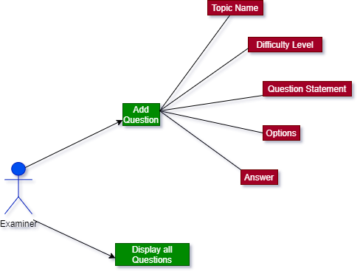

Slide 4
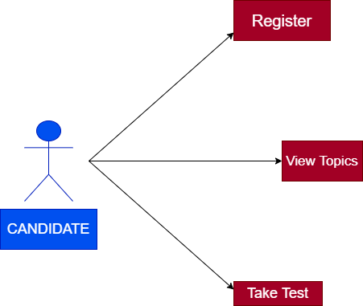

Slide 5
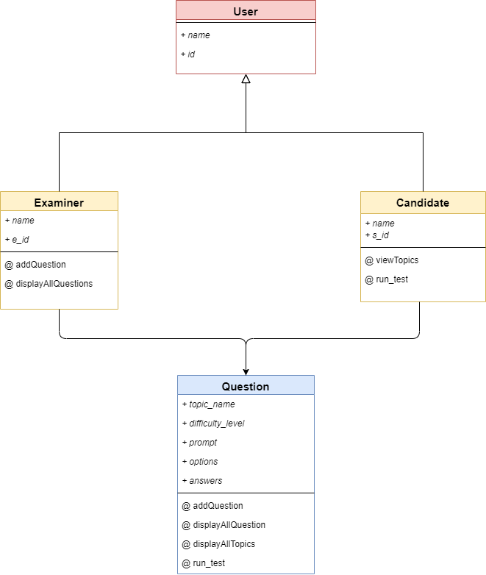
USE
CASE
Diagram

